Slide 1
WOMEN AND MEN IN TECHNOLOGY

Slide 2
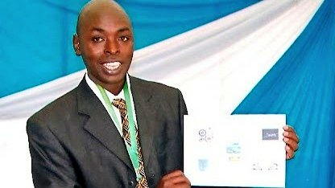
NYAGAKA ANYONA OUKO
March 2007
JKUAT student
Invented Mpesa( the world’s leading mobile money transfer)
By 2016 almost 29.5 m active customers had been served by more than 287400 agents

Slide 3

GEOFFREY GICHEHA,CYRUS KIPCOTICH AND SIMON WAMBUA
2015
computer science 4th year students from Maseno university
Invented BIMA BORA INSURANCE APP
It helps someone in purchasing insurance cover right from your phone with the possibility of comparing different ensurance covers and choosing the one that fit you best

Slide 4
Kevin Burke
Sept 4,2018
Moi university
Invented TSA Masomo app
Enables a student to conveniently access coursework , revision…
Registered members can access revision materials and past exam papers

Slide 5
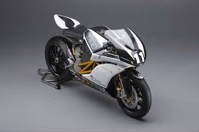
Charles Ogingo, Robert Achoge and James Ogola
all final year students
Oct 2015
Invented a system called Ecotran
Which captures the sun’s energy, stores it in batteries, and uses it to charge a motorcycle’s electric motor.

Slide 6
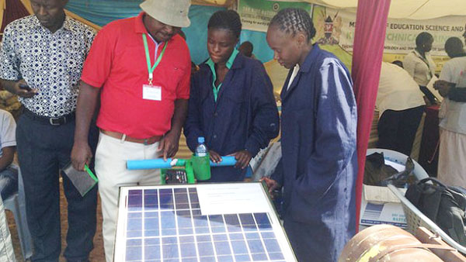
Emma Masibo and Lucy Bwire
students from Sang’alo Technical Institute in Bungoma
A solar-powered mower
May 16, 2016
To facilitate mowing at night, the solar mower has a bulb that provides lighting

Slide 7
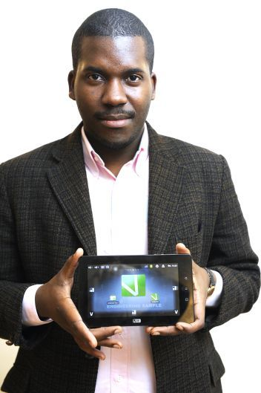
Verone Mankou
Jan. 30, 2012 he founded VMK and the inventor of Way-C tablet
He is also the creator of the first
African made mobile phone, Elikia (“Hope”).
Also increased internet
access in the country (DRC)

Slide 8
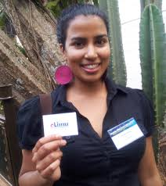
Nivi Mukherjee
Aug 10, 2015 :the co-founder and CEO of eLimu, an interactive educational platform with rich
digital localized content for the
Kenyan Primary School curriculum.
. She also runs Maisha ni matamu
a social project that aims to bring
a day full of joy every month to
children who are underprivileged
and/or orphaned.

Slide 9
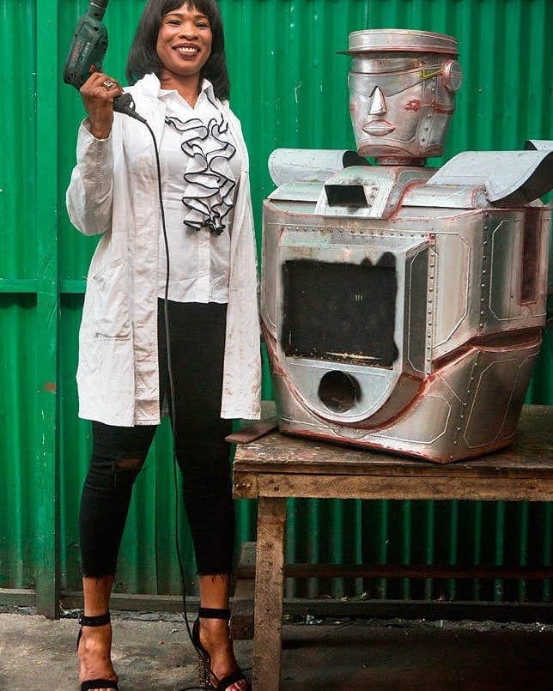
Thérèse Izay,congolese
an engineer from Kinshasa (Congo)
2013:designed traffic robots
that were initially placed in
two locations their
By 2015 five robot traffic police
were in use in Kinshasa
and one in Lubumbashi.

Slide 10
Seth Rono
Egerton University
Invented Air post Social :
is a social media platform that
mainly targets young Africans
It operates like facebook and twitter
Users an also stream and
listen to music, sell or buy goods

Slide 11
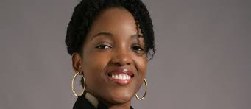
Ngalula Mubenga(congolese)
an electrical engineer at the University of Toledo
Mar 7, 2018
Invented a new alternative
technology designed to equalise
battery power referred to as a “bilevel equalizer.”
It could lead to longer-life batteries

Slide 12
Everyone can invent something as long as you have the passion on it
Thank you

